Slide 1
Harvard FinTech Online short course
Problem number and title: Problem 4:
Next generation lending networks
Please use this template to create your slide deck presentation.
Your slide deck should include 10 to 15 slides (not counting this cover page) in which you clearly articulate the problem, and propose your solution.
Click on “New Slide” in the Home toolbar to add slides to this template. Please feel free to reformat this template as much as you would like.
When you have finished creating your slide deck, upload it to the Online Campus in Module 6, along with your capstone project document.

Slide 2
The US Mortgage market is hugely important: at $11 trillion as of Q4 2021 (growing 9% YoY) and making up 70% of the US Household debt

Slide 3
The problem: From origination to securitization, the US Mortgage market is very manual & inefficient
Very high intermediation costs
$7,000 – $9,000 origination cost per loan
Highly manual underwriting process
4–5 underwriter reviews per file
Long client waiting times
>45 days to obtain mortgage/refinancing
Sources: McKinsey & Company, “Five trends reshaping the US home mortgage industry” Dec 2021; “Finnovators” podcast, Interview with Mike Cagney, Sep 2021; Provenance white-paper, 2019

Slide 4
The problem: From origination to securitization, the US Mortgage market is very manual & inefficient (continued)
Huge fees in securitization ecosystem
~$30bln in annual fees for securitization
Highly manual securitization process
6–8 intermediates reviews per security
Long passthrough times for investors
~55 days to receive cash flows from underlying assets
Sources: McKinsey & Company, “Five trends reshaping the US home mortgage industry” Dec 2021; “Finnovators” podcast, Interview with Mike Cagney, Sep 2021; Provenance white-paper, 2019

Slide 5
Using blockchain, Provenance.io is on a mission to make the $300 trillion in global financial markets more cost efficient, transparent and liquid
Provenance.io functions:
Ledger
Registry
Exchange
Why blockchain:
Decentralized record keeping
Immutability of information
Trustlessness
Figure Technologies, company that created Provenance.io*, is spear-heading the adoption of this blockchain platform to demonstrate the cost & risk reductions that can be achieved.
The first target was the mortgage market
Sources: Provenance white-paper, 2019; Provenance securitization whitepaper, 2020; “Finnovators” podcast, Interview with Mike Cagney, Sep 2021
Note: *Provenance.io is independent from Figure Technologies and is run by a Delaware non-stock corporation

Slide 6
FLOC 2020–1 $149mln mortgage securitization on Provenance.io in March 2020 demonstrated the cost & time savings using the blockchain platform:
Estimated cost savings:
Time savings:
Loan approval in less than 5 mins for most applicants
Passthrough rate of cashflows in securitization: immediate
Process | Cost savings
Origination | 23 bps
Servicing | 26 bps
Financing | 45 bps
Securitization | 23 bps
Total | 117 bps
Sources: Provenance white-paper, 2019; Provenance securitization whitepaper, 2020; “Finnovators” podcast, Interview with Mike Cagney, Sep 2021

Slide 7

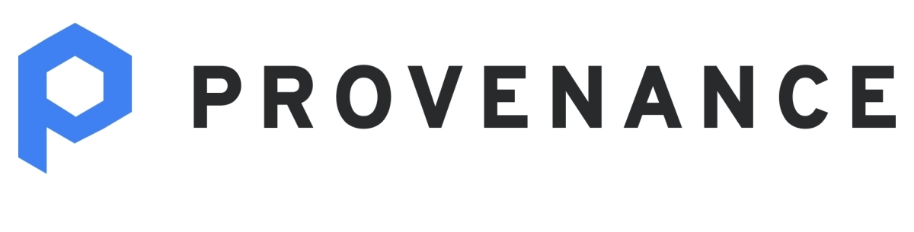



Provenance/Figure strategy in one sentence: growing the value of Hash by driving Provenance.io & USDF adoption through lending, exchange, & payments businesses
Client facing
Revenue generating
Community based
Non-revenue generating
Utility token
Valuation growth
Lending
Blockchain platform
The coin to pay for the gas fees on Provenance.io
Current market cap: $9.8bln
70% held by Figure
Investing | Marketplace
Stable-coin consortium
Payments app | Acquiring

Slide 8
Can Provenance succeed? Strengths / value drivers
Tangible blockchain use-case and value-add through:
Cost savings, by reducing third party / operational / capital expenses related to manual & administrative / audit processes
Risk mitigation, by reducing settlement and counterparty risk, through use of automated smart contracts and instant bilateral settlements
Revenue enhancement, by increasing transparency with real-time data, reducing friction, improved liquidity, and enabling bespoke products, that were not economically viable before
Highly scalable platform that can support up to 10’000 transactions per second
Massive addressable market size, which is ripe for disruption: $300 trillion global fixed income, public & private equity markets with $100 billion opportunity for Provenance
Strong, visionary team: Mike Cagney (founder and former CEO of SoFi), Morgan McKenney (formerly at Citi), and experienced team & advisors
Traction: over $5 billion has already been originated, financed and securitized on Provenance, with rapid growth after the acquisition of Homebridge in Aug. 2021
Sources: Provenance white-paper, 2019; Provenance securitization whitepaper, 2020; “Finnovators” podcast, Interview with Mike Cagney, Sep 2021; “The Blockchain Interviews” podcast, Nov 2021

Slide 9
Can Provenance succeed? Weaknesses and challenges
Regulation
Highly regulated market: Currently Figure/Provenance has over 200 licenses across the US. It applied for Bank charter with the OCC in Nov 2020, but the results are still unclear. Expanding to markets beyond the US will similarly have major regulatory hurdles.
Hash IPO plans were derailed: The team changed Hash positioning from a public security to a utility token.
Not truly decentralized: Provenance.io is actually not truly decentralized, as ~70% of Hash was held by Figure and while that figure was expected to go down, the path towards true decentralization is not clear.
Not focused: Figure/Provenance team seems to be doing too many things on too many fronts, from loan origination, to securitization, to exchanges, to payments, to investments, to marketplace, to USDF stablecoin consortium, etc.
Sources: Provenance white-paper, 2019; Provenance securitization whitepaper, 2020; “Finnovators” podcast, Interview with Mike Cagney, Sep 2021

Slide 10
How to maximize chances of ultimate success of Provenance.io?
What does success look like for Provenance.io? Let’s assume that’s maximum adoption by all DeFi projects, and Provenance.io overtaking Ethereum
The team has been doing remarkably well. However, strategically, there can be two important areas to improve:
Concentrated Hash ownership:
Issue: As long as 70% of Hash is held by Figure, the lack of true decentralization will hinder the massive adoption of Provenance.io.
Suggestion: The team should decrease their ownership of Hash or introduce a separate governance token that would be held more broadly.
Possible downside: Reducing ownership of Hash can significantly limit the economic upside for the company. But if it helps with adoption, eventually owning a smaller piece of a much larger pie may be a better strategy.
Conflict of interest:
Issue: As long as Figure acts on the client-facing side of business, conflict of interest may limit adoption of Provenance.io by other client-facing banks / DeFi apps / exchanges / etc.
Suggestion: Provenance.io must distance itself from the direct client-facing part of business, focus on bringing other players onto the platform.
Possible downside: The client-facing part of business may be needed initially to spearhead the adoption by other banks / players / DeFi institutions. Choosing the right time to exit is important.

Slide 11
Summary
Provenance.io is part of an ecosystem, that is trying to disrupt established companies and systems, whose combined value is over trillion dollars:
Disrupting rent-seeking massive lending, exchange and payments businesses (competing with traditional banks, registries, stock exchanges, money transfer businesses, Visa/Mastercard/PayPal, and many other players in this area)
Creating the go-to platform for DeFi applications (competing with Ethereum)
Growing towards a ubiquitous use of USDF as trusted, bank-minted stablecoin (competing with USDT, USDC, Terra, etc, none of which are bank minted)
There is a strong, experienced team behind the project that has been delivering. FLOC2020-1 securitization by Figure/Jefferies/Nomura has saved over 117bps in the origination to securitization cycle, while later issuances on platform by others has saved 125–130bps. Furthermore, origination time for clients was reduced from 45 days to less than 5minutes
However, there are three main areas that the team needs to be careful and proactive with: 1) regulation, 2) concentrated ownership of Hash (limiting true decentralization), and 3) potential conflict of interest being on both the platform and the client facing side of the business.

